Slide 1
Chapter 14
Introduction to Spatial Vector Analysis
The term vector has slightly different meanings in different areas of mathematics, engineering and science. Throughout the text thus far, the term has been used to refer to row or column matrices according to the standard conventions of matrix algebra, and these conventions are in turn employed by MATLAB.

Slide 2
Another widely used definition for vector is associated with spatial quantities that have specific directions in terms of the three-dimensional coordinate system in which we live. Examples of such quantities are forces, velocities, displacements, electric fields, magnetic fields, and many other physical variables. A three-dimensional spatial vector can be represented in terms of a row or column vector in MATLAB. There are certain mathematical operations that are useful in describing these quantities and the subject area is called vector analysis.

Slide 3
For the purposes of this chapter, a spatial vector will be defined as a quantity that has both a magnitude and a direction. Since the focus throughout the chapter will be on spatial vectors, the adjective spatial will often be omitted. At any point at which a MATLAB vector is created, the terms row vector and column vector will be used as appropriate.

Slide 4
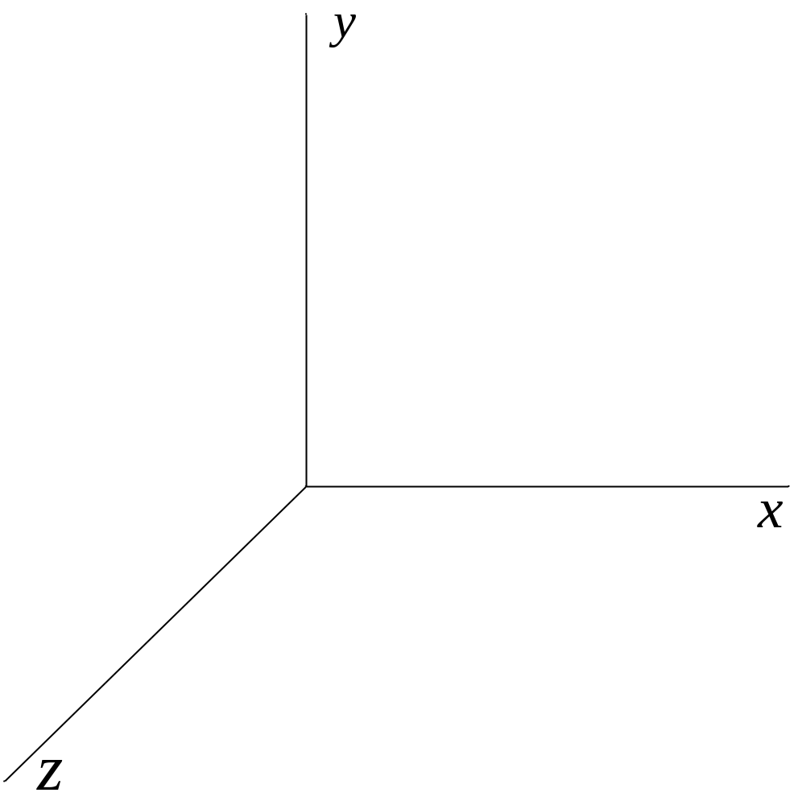
Rectangular Coordinate System

Slide 5
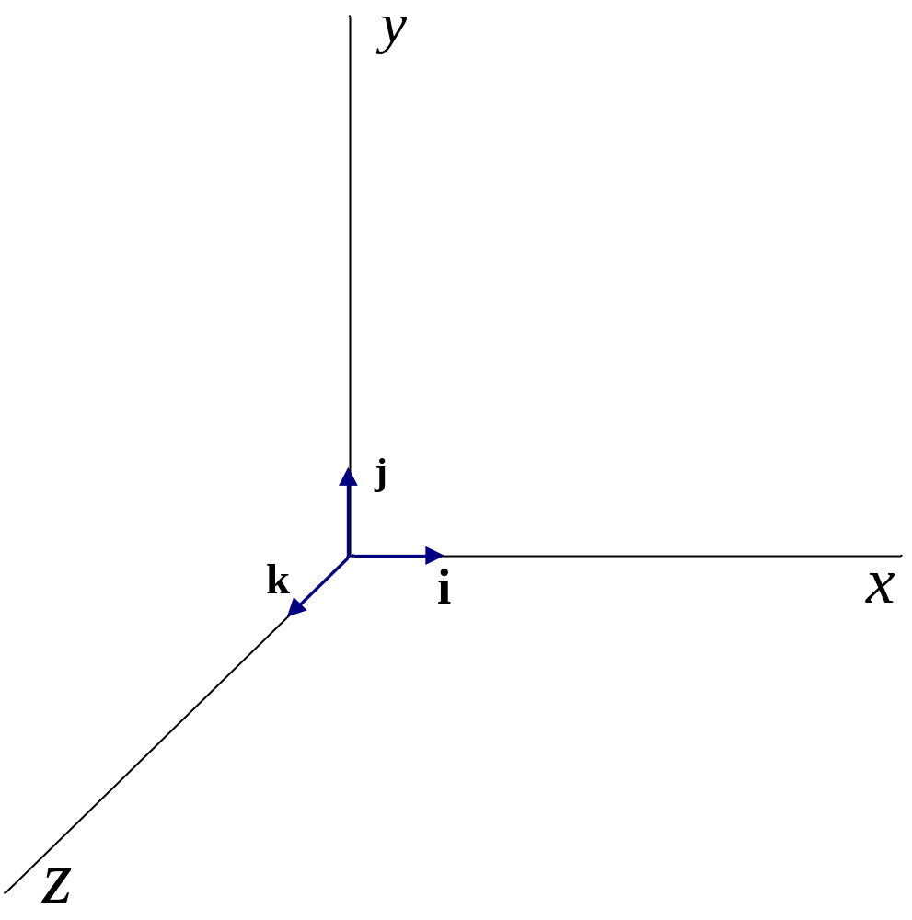
Unit Vectors in Rectangular Coordinate System

Slide 6
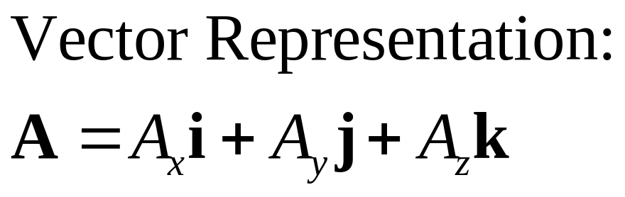
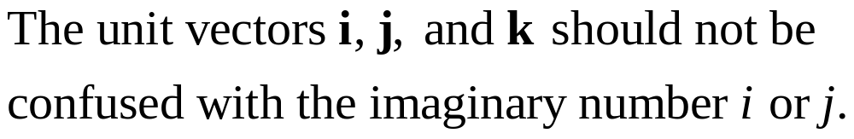
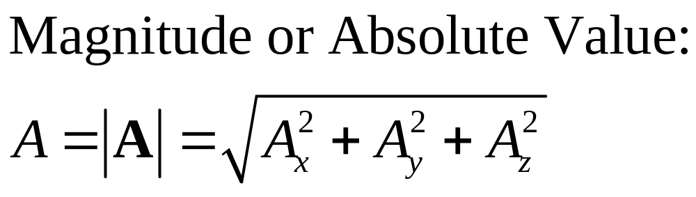

Slide 7
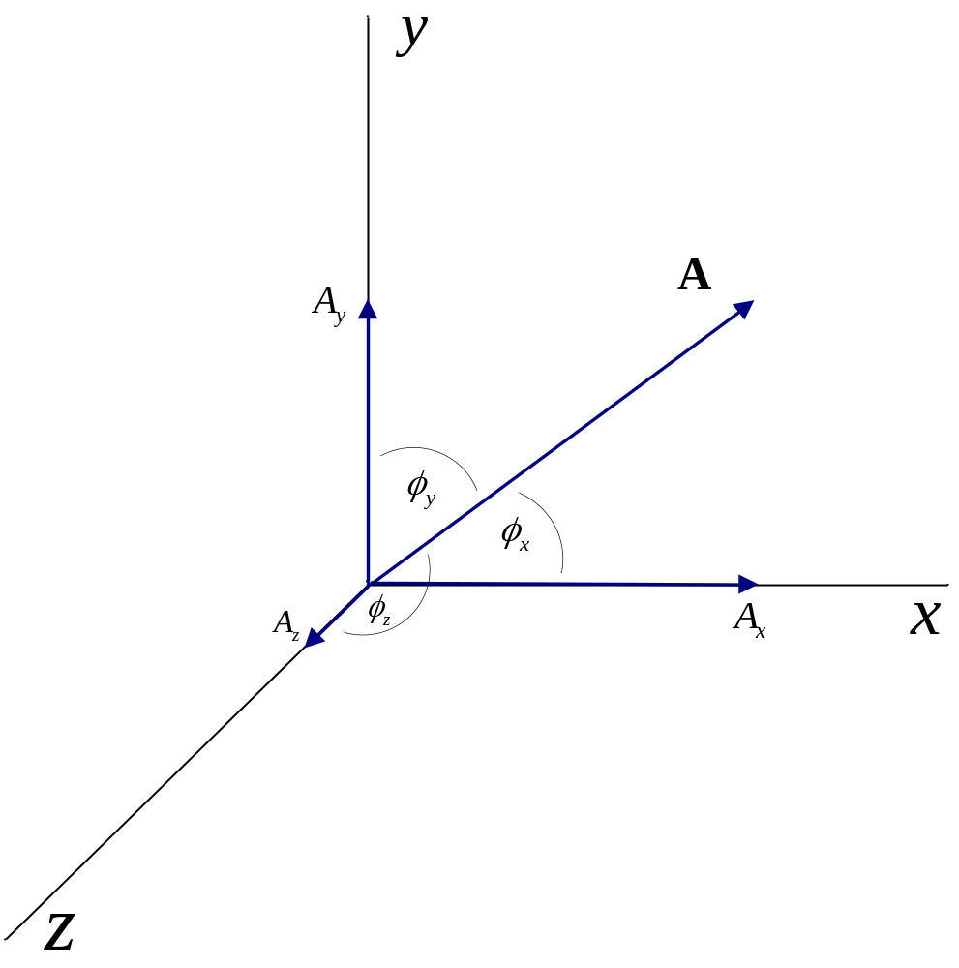
Direction Angles

Slide 8
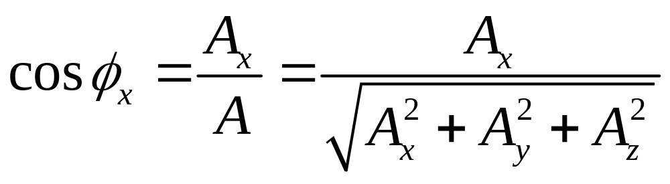
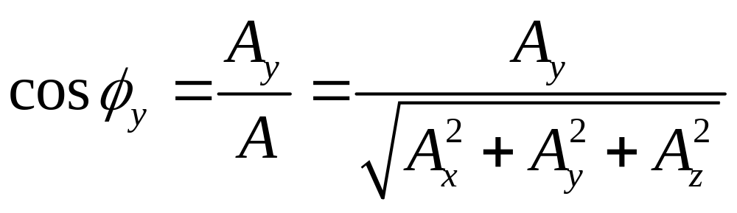
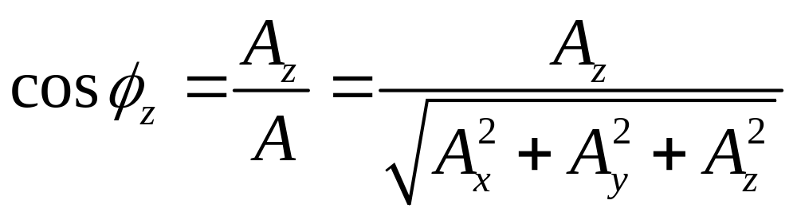
Relationships for Direction Angles

Slide 9
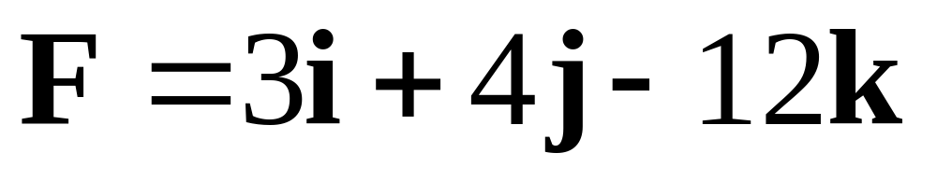
Example 14-1. A force has x, y, and z components of 3, 4, and –12 N, respectively. Express the force as a vector in rectangular coordinates.

Slide 10
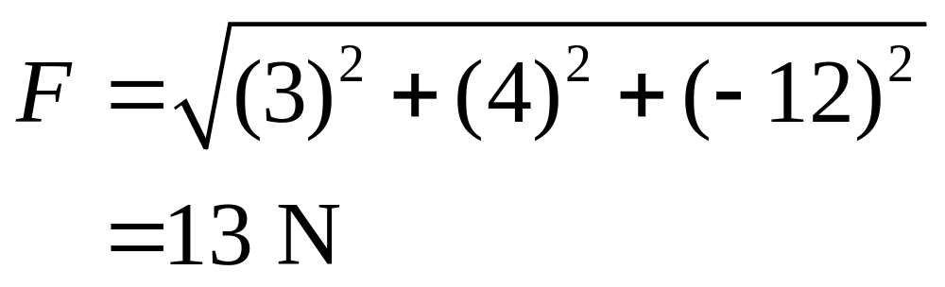
Example 14-2. Determine the magnitude of the force in Example 14-1.

Slide 11
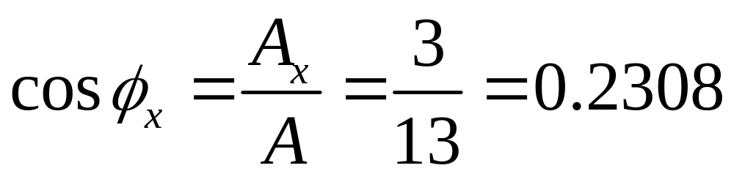
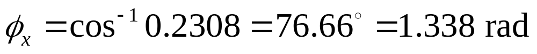
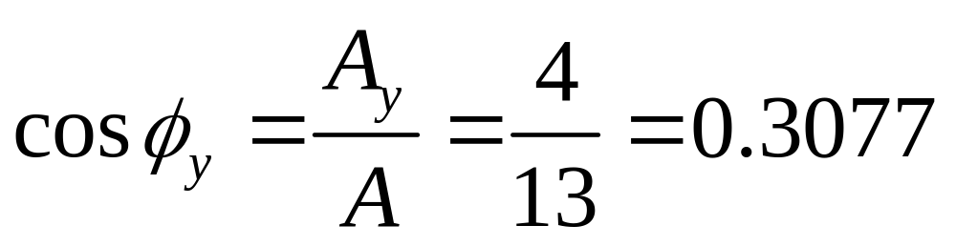
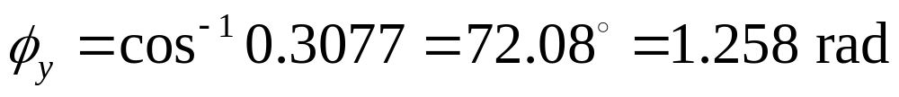
Example 14-3. Determine the three direction angles for the force of Examples 14-1 and 14-2.

Slide 12
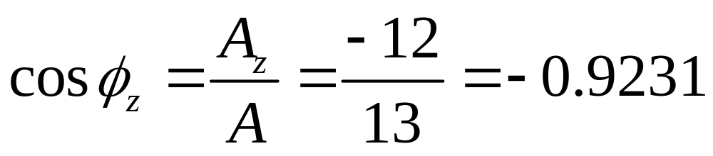
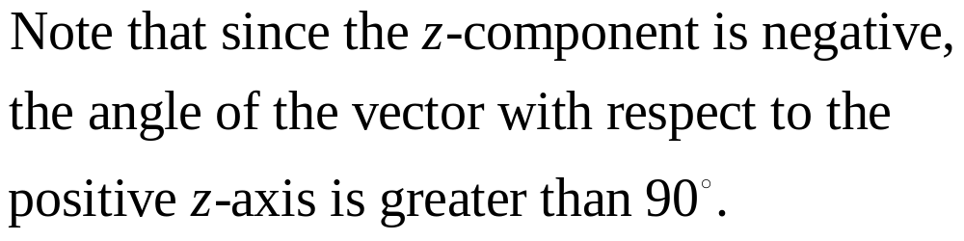
Example 14-3. Continuation.

Slide 13
Vector Operations to be Considered
Scalar or Dot Product A•B
Vector or Cross Product AxB
Triple Scalar Product (AxB)•C

Slide 14
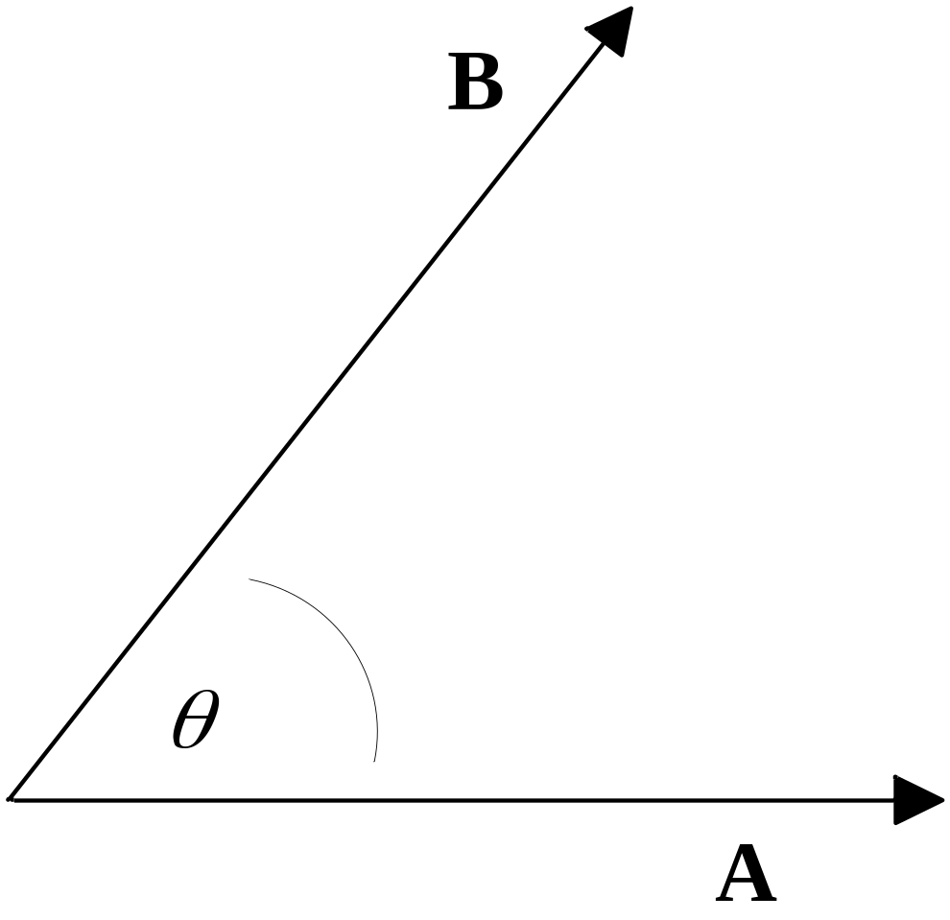
Consider two vectors A and B oriented in different directions.

Slide 15
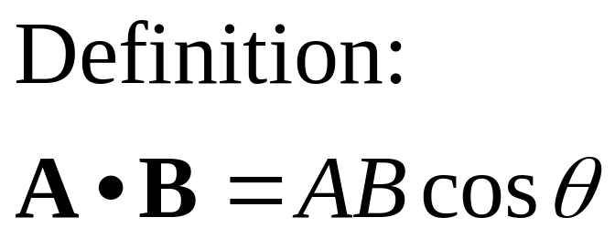
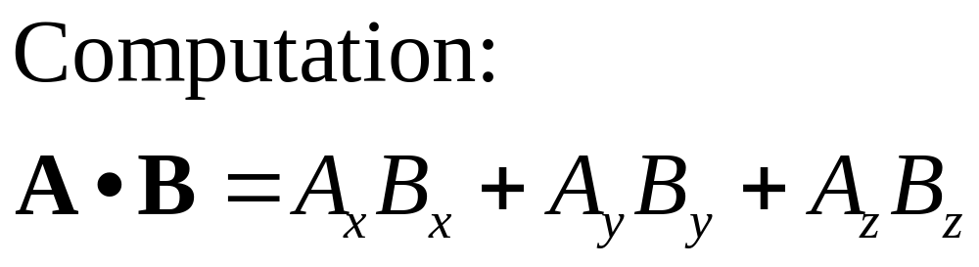
Scalar or Dot Product

Slide 16
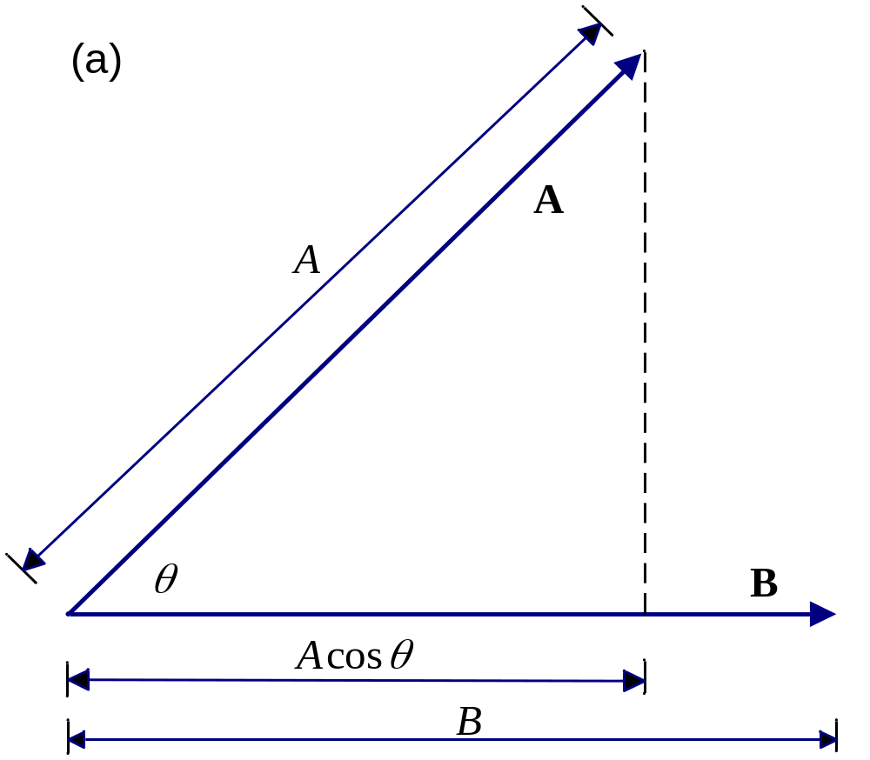
First Interpretation of Dot Product:
Projection of A on B times the length of B.

Slide 17
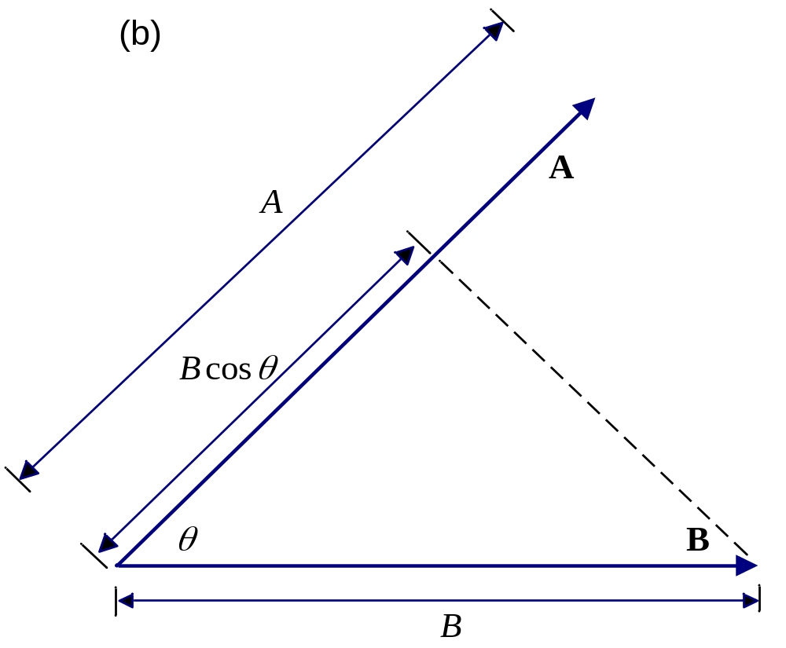
Second Interpretation of Dot Product:
Projection of B on A times the length of A.

Slide 18
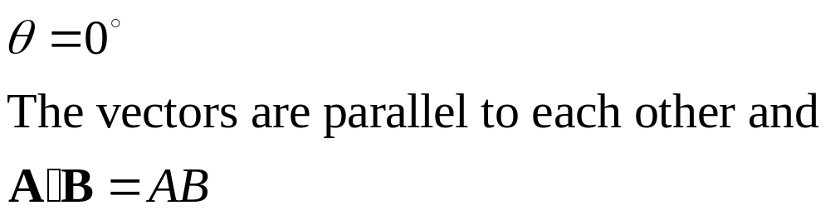
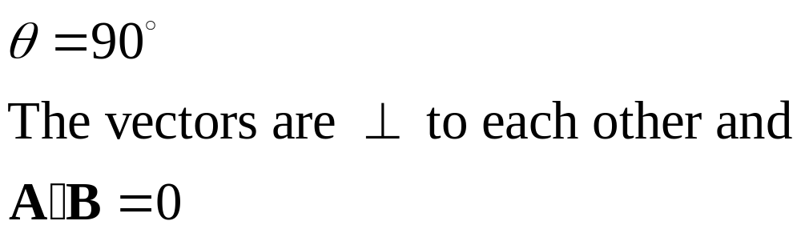
Some Implications of Dot Product

Slide 19
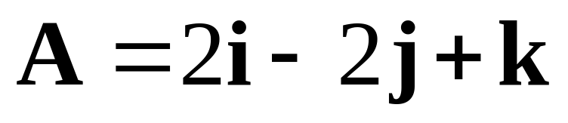
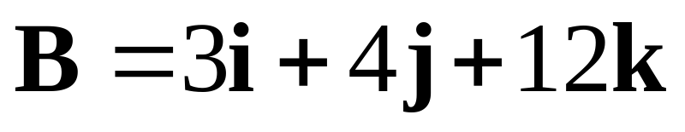
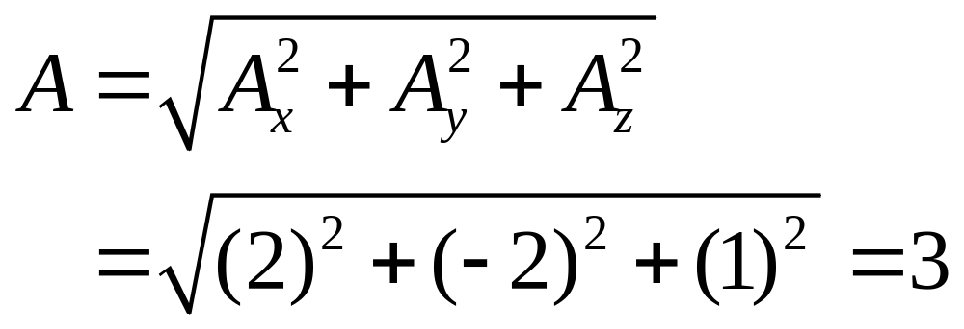
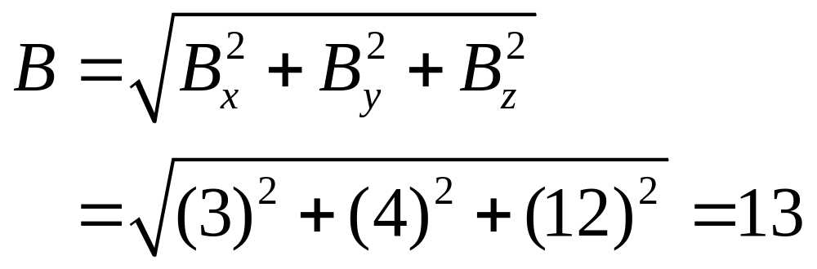
Example 14-4. Perform several scalar operations on the following vectors:

Slide 20
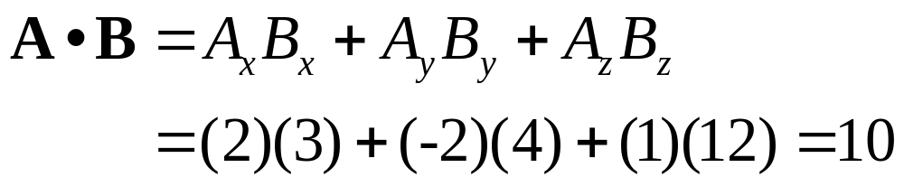
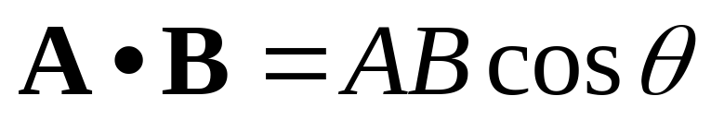
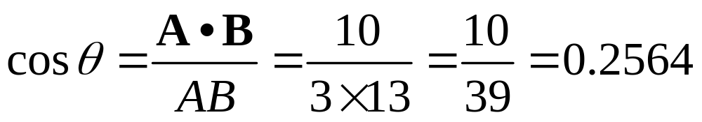
Example 14-4. Continuation.

Slide 21
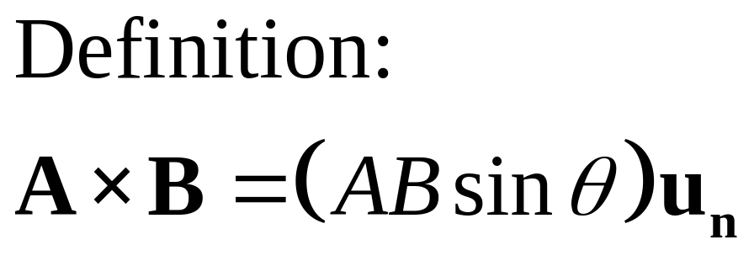
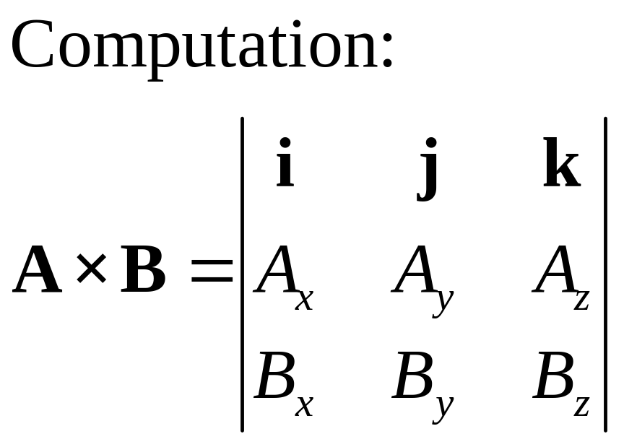
Vector or Cross Product

Slide 22
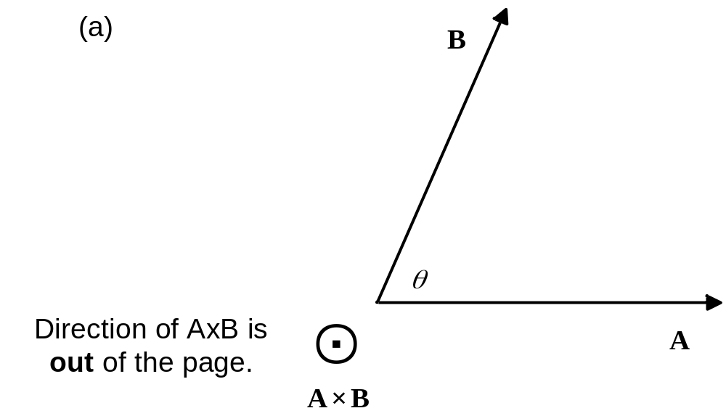
Cross Product AxB

Slide 23
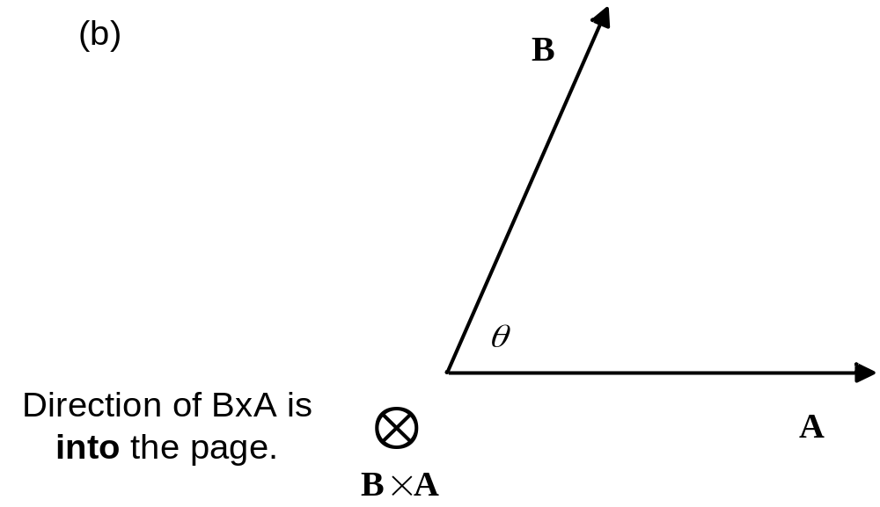
Cross Product BxA

Slide 24
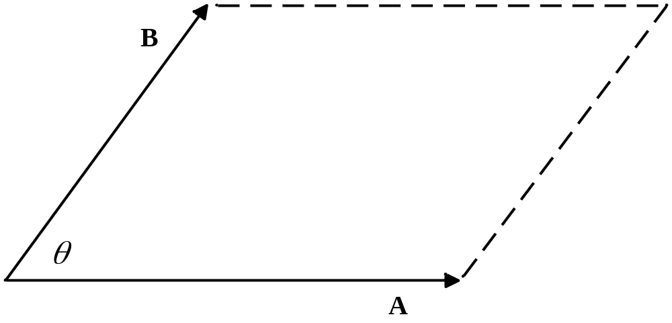
Area of parallelogram below is the magnitude of the cross product.

Slide 25
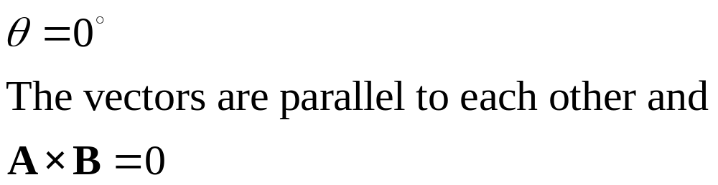
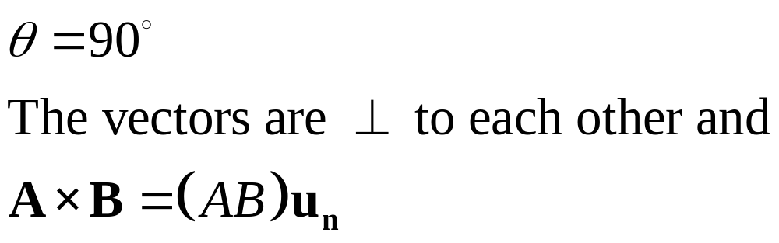
Some Implications of Cross Product

Slide 26
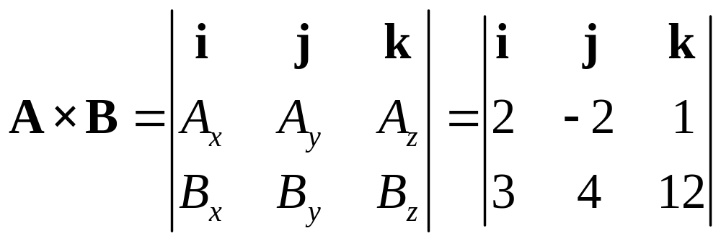
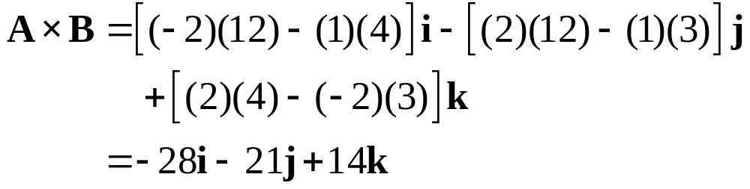
Example 14-5. Determine the cross product of the vectors of Example 14-4.

Slide 27
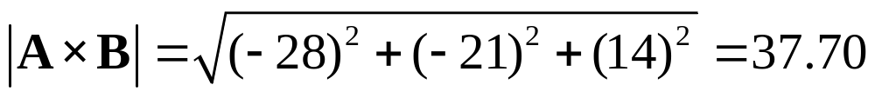
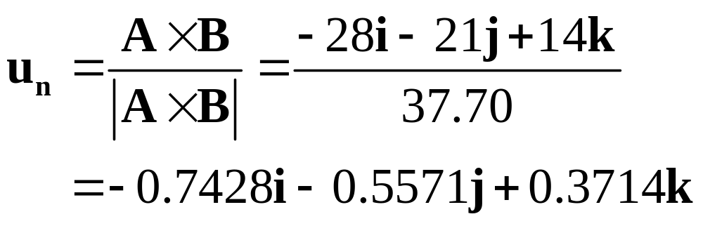
Example 14-6. Determine a unit vector perpendicular to the vectors of Examples 14-4 and 14-5.

Slide 28
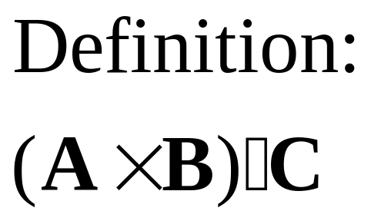
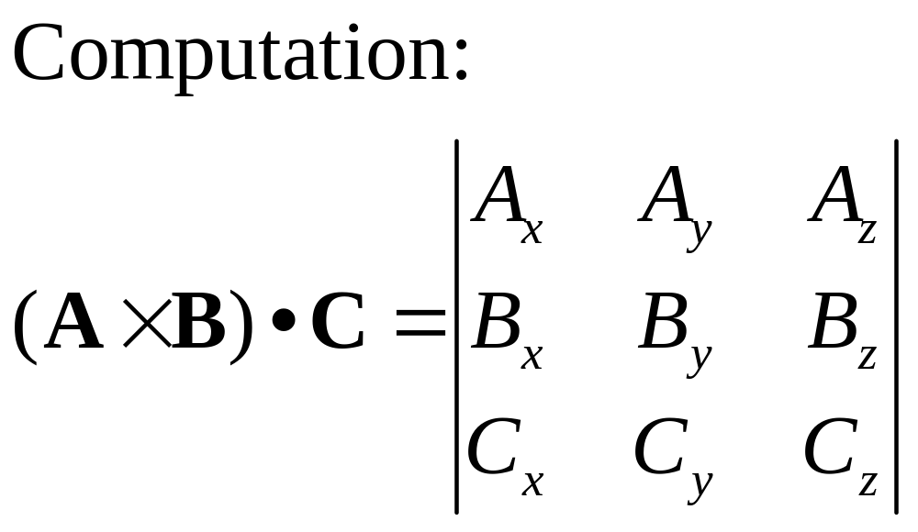
Triple Scalar Product

Slide 29
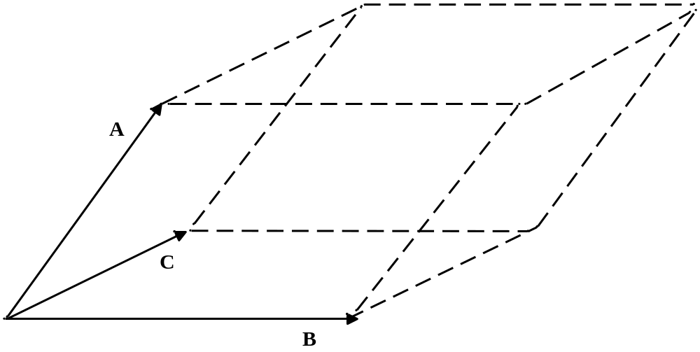
Volume of parallelepiped below is the triple scalar product of the vectors.

Slide 30
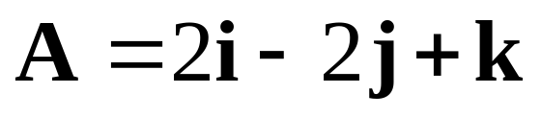

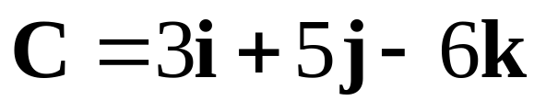
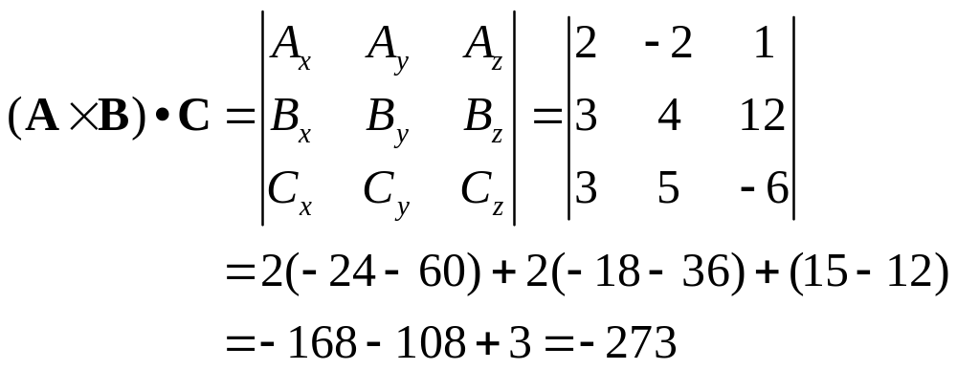
Example 14-7. Determine the triple scalar product of the vectors

Slide 31
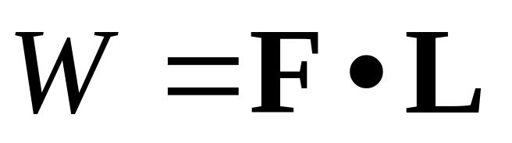
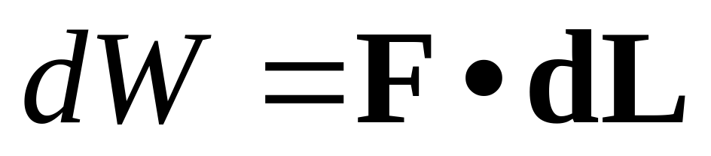
Work and Energy
Let F represent a constant force vector and let L represent a vector path length over which the work W is performed. The first equation below will determine the work. If the force is a function of the position, the differential form is required.

Slide 32


Force on Current Carrying Conductor

Slide 33


Force Resulting in Torque Vector

Slide 34

Voltage Induced in Moving Conductor
Assume that a conductor of vector length L is moving with vector velocity v through a magnetic field vector B. The voltage measured across the length is given by the triple scalar product that follows.

Slide 35
MATLAB Dot Product
>> A = [Ax Ay Az]
>> B = [Bx By Bz]
>> P_dot = dot(A, B)
The magnitude of a vector A can be determined by the following command:
>>A_mag = sqrt(dot(A, A))

Slide 36
MATLAB Cross Product
>> A = [Ax Ay Az]
>> B = [Bx By Bz]
>> P_cross = cross(A,B)

Slide 37
MATLAB Triple Scalar Product
>> A = [Ax Ay Az]
>> B = [Bx By Bz]
>> C = [Cx Cy Cz]
>> P_triple = det([A; B; C])

